Slide 1
MLP-Mixer: An all-MLP Architecture for Vision
Paper Presentation I
Ilya Tolstikhin*, Neil Houlsby*, Alexander Kolesnikov*, Lucas Beyer*, Xiaohua Zhai, Thomas Unterthiner, Jessica Yung, Andreas Steiner, Daniel Keysers, Jakob Uszkoreit, Mario Lucic, Alexey Dosovitskiy
(Google Research, Brain Team)
Keywords: Deep Learning、Machine Learning、Transformers、Vision、Transfer Learning
資科所碩一 7110095012 黃皓偉

Slide 2
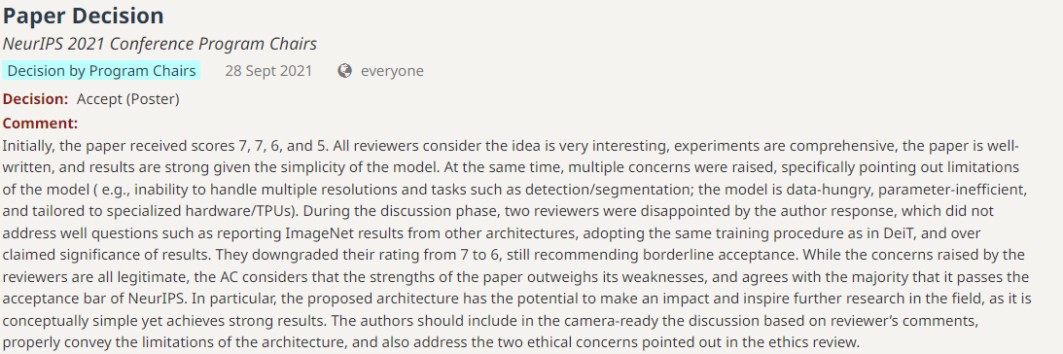
Paper Information
Conference: NeurIPS (2021)
Presentation Type: Poster

Slide 3
Outline
Introduction
Paper Review
The proposed Method
Experimental Results
Conclusions
Future Work

Slide 4
Introduction
Computer Vision (CV):
Convolutional Neural Networks (CNNs) => convolutions
Vision Transformers (ViT) => self-attention
=> Do we need to use convolutions or self-attention ?
MLP-Mixer
(Mixer)

Slide 5
Paper Review
CNNs have been the de-facto standard in computer vision since the AlexNet model
ViT achieves state-of-the-art performance on popular vision benchmarks while retaining the robustness of CNNs
Mixer borrows design choices from recent transformer-based architectures
Converting images to a sequence of patches and directly processing embeddings of these patches originates in ViT
Notes:
Attention is all you need
AlexNet: ImageNet 2012 No.1

Slide 6
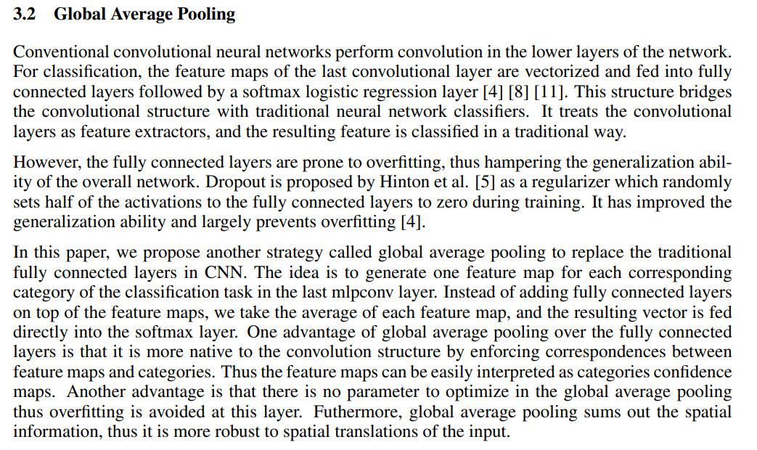
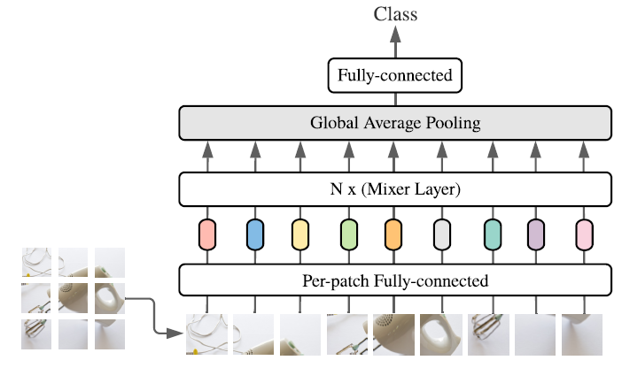
The Proposed Model (1/3)
M. Lin, Q. Chen, and S. Yan. Network in network. In ICLR, 2014
label prediction
replace the traditional
fully connected layers in CNN
main structure
original image
projected patches
(C)
image patches
(S)
MLP-Mixer
Notes:
1. Loss function: cross entropy

Slide 7
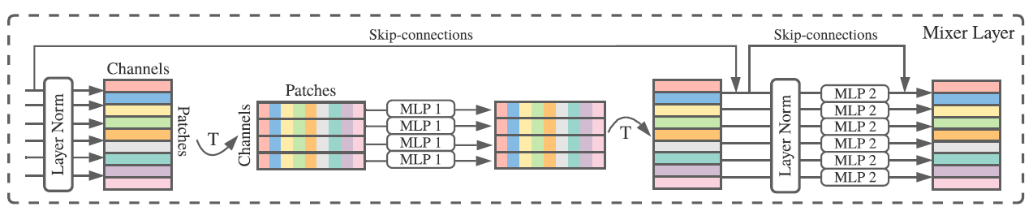
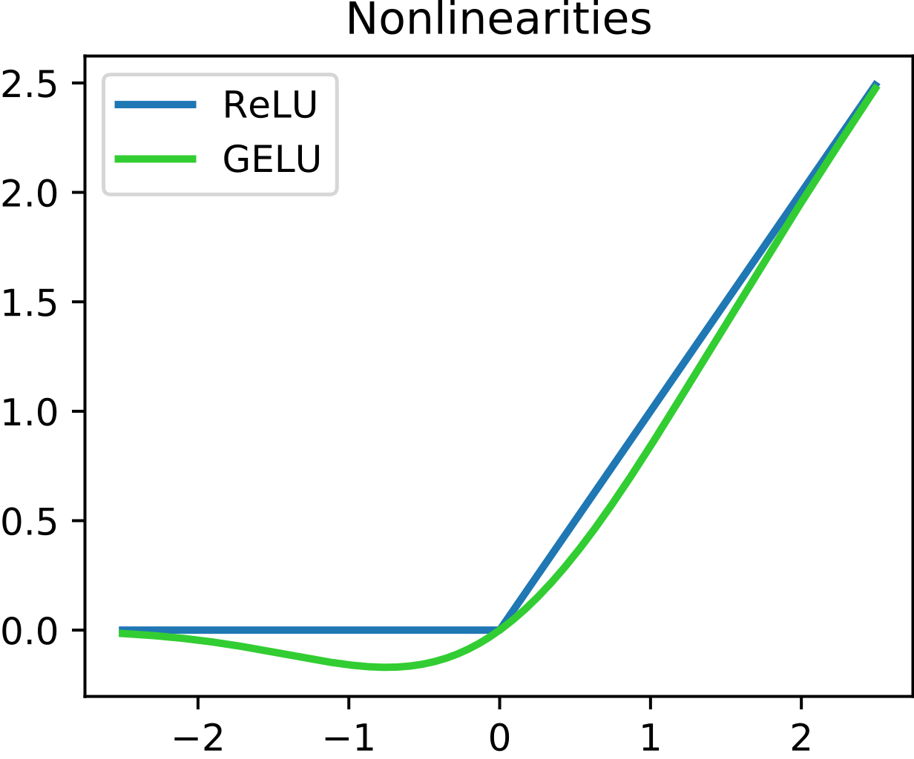
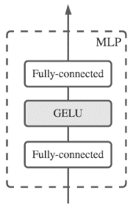

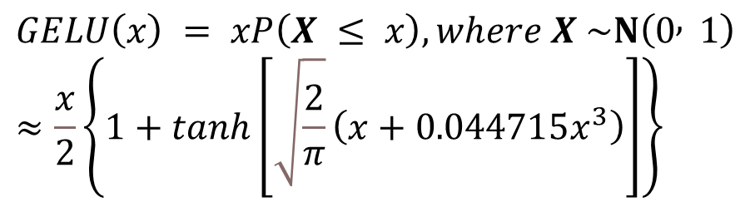
The Proposed Model (2/3)
LayerNorm(X)
LayerNorm(U)
Y
X
U
Mixer layers
MLP
$$GELU\left(x\right) = xP\left(X ≤ x\right), where X \sim N\left(0 , 1\right)≈\frac{x}{2}\left\{1+tanh\left[\sqrt{\frac{2}{π}}\left(x+0.044715x^{3}\right)\right]\right\}$$
D. Hendrycks and K. Gimpel. Gaussian error linear units (GELUs). arXiv preprint
arXiv:1606.08415, 2016

Slide 8
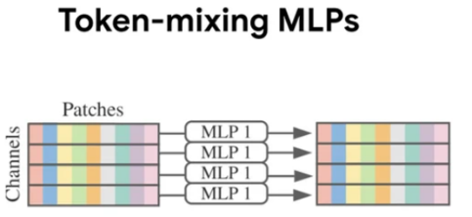
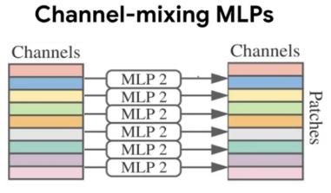
The Proposed Model (3/3)
[Modern deep vision architectures consist of layers that mix features]
1. at a given spatial location
2. between different spatial locations
Mixer layers
Model | Features 1 | Features 2
CNNs | 1*1 convolutions larger kernels | N * N convolutions (N > 1) Pooling larger kernels
attention-based (e.g.ViT) | self-attention layers MLP-blocks | self-attention layers
MLP-Mixer | channel-mixing | token-mixing
(per-location)
(cross-location)

Slide 9
Experimental Results (1/7) Three quantities
Downstream tasks
Datasets | Description
ILSVRC2012 (ImageNet) | 1.3M training examples, 1k classes (original validation labels + cleaned-up ReaL labels)
CIFAR-10/100 | 50k examples, 10/100 classes
Oxford-IIIT Pets | 3.7k examples, 36 classes
Oxford Flowers-102 | 2k examples, 102 classes
VTAB-1k | 19 diverse datasets, each with 1k training examples
1. Accuracy on the downstream task
2. Total computational cost of pre-training
3. Test-time throughput
※Our goal is not to demonstrate state-of-the-art results, but to show a simple MLP-based model is competitive with today’s best convolutional and attention-based models
Notes:
Total computational cost of pre-training, which is important when training the model from scratch on the upstream dataset
Test-time throughput, which is important to the practitioner

Slide 10
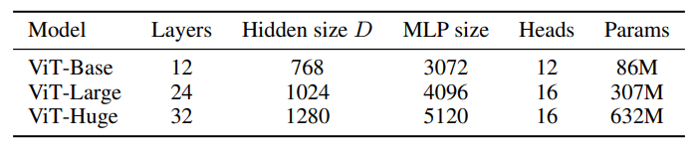
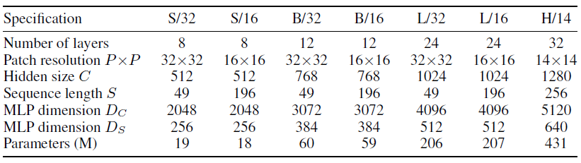
Experimental Results (2/7) Pre-training
Public datasets: ILSVRC2021 ImageNet、ImageNet-21k
Proprietary datasets: JFT-300M (300M examples and 18k classes)
Input resolution: 224
Specifications of the Mixer architectures
Notes:
ImageNet-21k, a superset of ILSVRC2012 that contains 21k classes and 14M images
The number of parameters is reported for an input resolution of 224 and does not include the weights of the classifier head

Slide 11
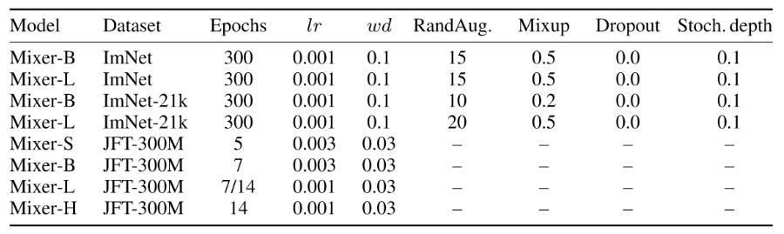
Experimental Results (3/7) Implementation details
Hyperparameter settings used for pre-training Mixer models

Slide 12
Experimental Results (4/7) Fine-tuning
[Details]
Optimizer: momentum SGD
Batch size: 512
Gradient clipping: global norm 1 (gradient explosion)
Linear warmup: cosine learning rate
Weight decay
Notes:
ImageNet-21k, a superset of ILSVRC2012 that contains 21k classes and 14M images
The number of parameters is reported for an input resolution of 224 and does not include the weights of the classifier head
https://blog.csdn.net/Roaddd/article/details/113260677 (cosine learning rate)

Slide 13
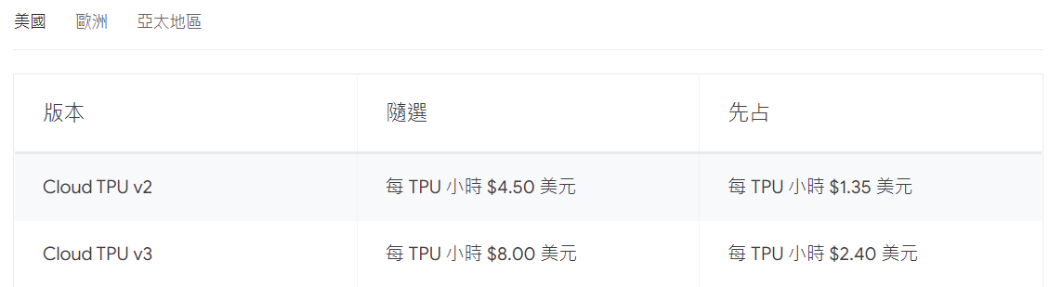
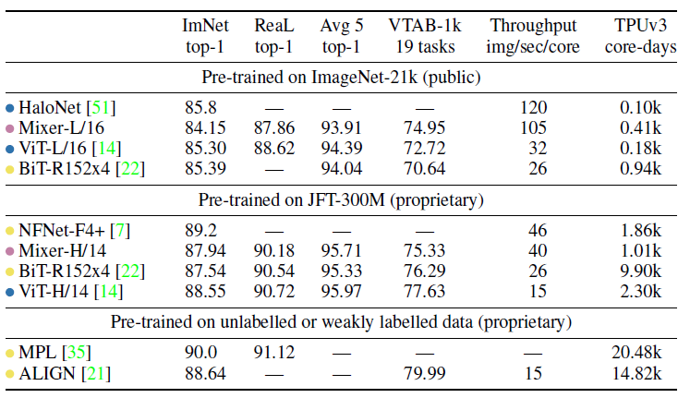
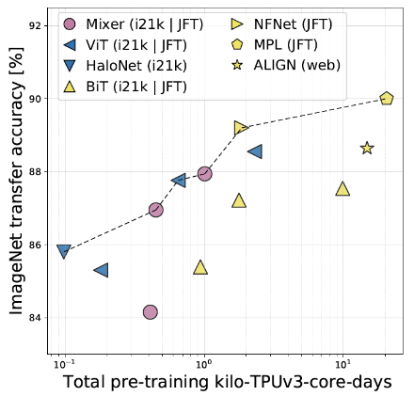
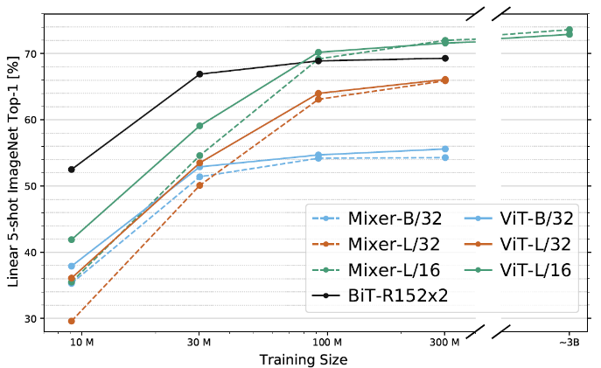
Experimental Results (5/7)
Transfer performance, inference throughput, and training cost
(resolution: 448)
ImageNet accuracy/training cost
ImageNet accuracy/training cost
Notes:
MLP-based Mixer models are marked with pink, convolution-based models with yellow, and attention-based models with blue
HaloNets are attention-based models that use a ResNet-like structure with local selfattention (cnn + attention)
Big Transfer (BiT)
Mixer performance numbers are averaged over three fine-tuning runs and standard deviations are smaller than 0:1

Slide 14
Experimental Results (6/7) (fine-tune at resolution 224)
[The role of the model scale] (smaller Mixer models)
Mixer-H/14 pre-trained on JFT-300M and fine-tuned at 224 resolution is only 0.3% behind ViT-H/14 on ImageNet whilst running 2.2 times faster
[The role of the pre-training dataset size]
It appears that Mixer benefits from the growing dataset size even more than ViT
Notes:
While the former affects both pre-training compute and test-time throughput, the latter only affects the throughput. Unless stated otherwise, we fine-tune at resolution 224
We compare various configurations of Mixer (see Table 1) to ViT models of similar scales and BiT models pre-trained with Adam
When pre-trained on the smallest subset of JFT-300M, all Mixer models strongly overfit
As the dataset increases, the performance of both Mixer-L/32 and Mixer-L/16 grows faster than BiT; Mixer-L/16 keeps improving, while the BiT model plateaus

Slide 15
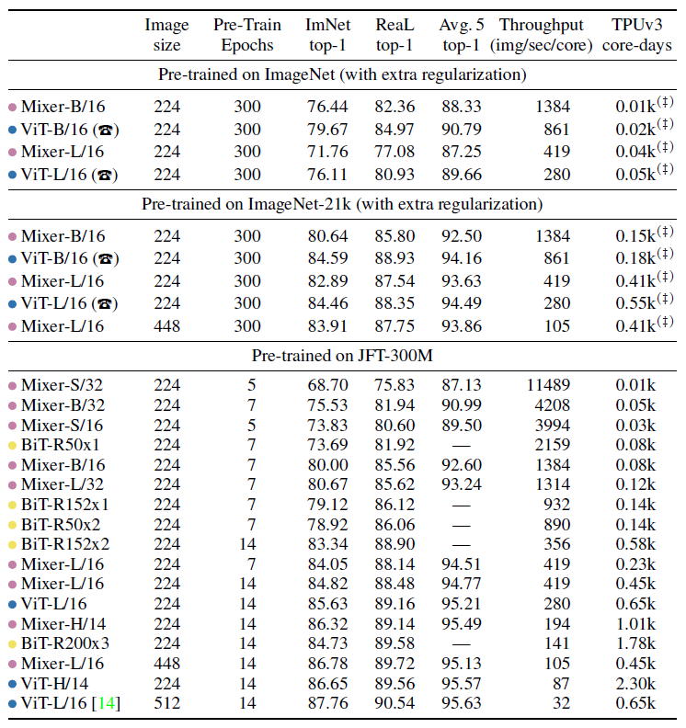
Performance of Mixer and other models from the literature across various model and pre-training dataset scales
Notes:
[sign] Extrapolated from the numbers reported for the same models pre-trained on JFT-300M without extra regularization
This is 3% behind the ViT-B/16 model. The training curves (not reported) reveal that both models achieve very similar values of the training loss
Comparison: EfficientNet-v2 gets 87.3, Swin 86.4, CvT 87.7

Slide 16
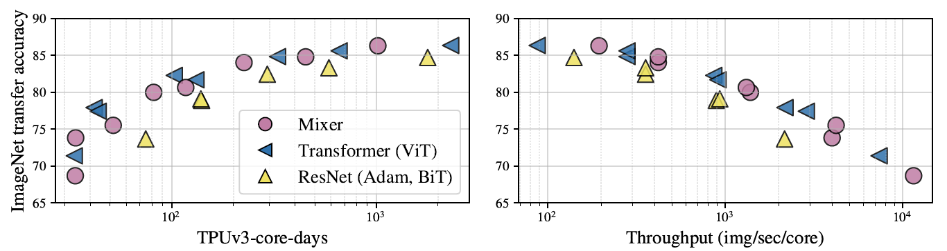
The role of the model scale (JFT-300M, fine-tuned at resolution 224)
Notes:
Figure 3 clearly demonstrates that although Mixer is slightly below the frontier on the lower end of model scales, it sits confidently on the frontier at the
high end
2.

Slide 17
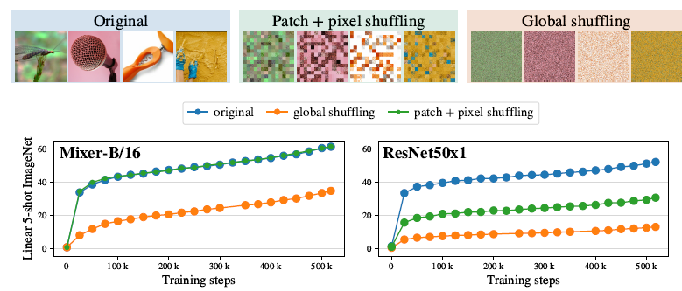
Experimental Results (7/7) Invariance to input permutations (inductive biases)
Difference between inductive biases of Mixer and CNN architectures (JFT-300M)
Notes:
1. Mixer’s performance drops much less (45% drop) compared to the ResNet (75% drop)

Slide 18
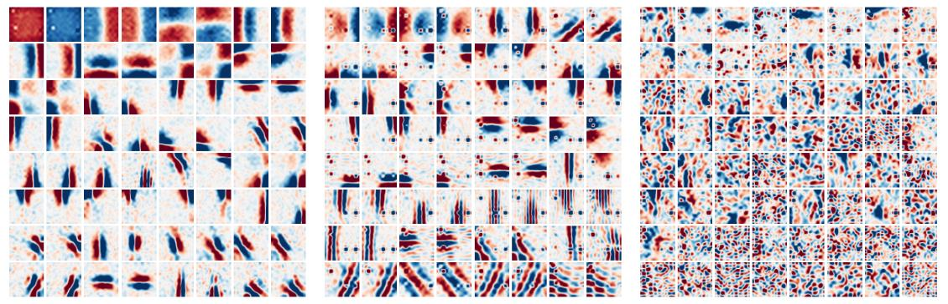
Experimental Results (/) Visualization
Difference between inductive biases of Mixer and CNN architectures (JFT-300M)

Slide 19
Conclusions
Simple architecture (Mixer) is as good as existing state-of-the-art (SOTA) methods for vision
Researchers hope that their results spark further research, beyond the realms of established models based on convolutions and self-attention
Mixers can not be easily applied to various resolutions and difficulty applying to tasks like detection and segmentation
Notes:
1. It would be particularly interesting to see whether such a design works in NLP or other domains

Slide 20
Future Work Paper Presentation II
[Goals]
To implement MLP-Mixer model using TensorFlow 2
To compare other models which mentioned by this paper
[Problems]
How to find the pre-train model?
How to find datasets I can use to compare models?
Is any model based on MLP-Mixer?

Slide 21
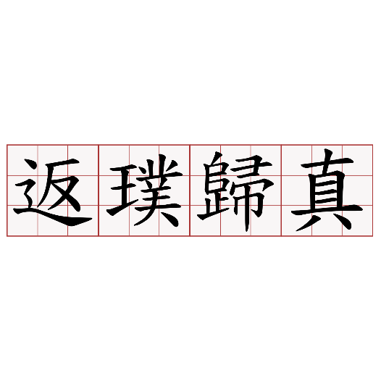
Thinks for listening ~

